Slide 1
1

Slide 2
Ports, Protocols & Services

Slide 3
2. Ports, Protocols & Services
3.1 Given a scenario, implement secure protocols
2.1 Explain the importance of security concepts in an enterprise environment

Slide 4
2. Ports, Protocols & Services
Communication Protocols
Network Protocols
Domain Name System (DNS)
SPF, DKIM & DMARC
Secure Shell (SSH)
Secure Socket Layer (SSL) /Transport Layer Security (TLS)
Web Browsing Protocols
File Transfer Protocols
Email Protocols
Directory Service Protocols
Voice & Video Protocols
Remote Desktop Protocol (RDP)
Simple Network Management Protocol
Network Timing Protocols

Slide 5
3.1 Given a scenario, implement secure protocols
Communication Protocols
Port
Ports take you to the correct service.
“WHERE to communicate”
Service Protocol
Establish the rules for systems communicating over the network
“HOW to communicate”
Example:
Protocol | Port
FTP data port (active mode) | tcp/20
FTP control port | tcp/21
SSH | tcp/22
SCP (uses SSH) | tcp/22
SFTP (using SSH) | tcp/22
Telnet | tcp/23
SMTP | tcp/25

Slide 6

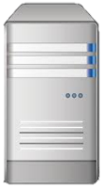

3.1 Given a scenario, implement secure protocols
Network Protocols
Transmission Control Protocol (TCP)
Connection-oriented network communication
Guaranteed delivery in the right order
Three-way handshake
User Datagram Protocol (UDP)
Connectionless network communication
Faster, but at the risk of lost packets
Common with streaming, gaming, VOIP
SYN
SYN / ACK
ACK
UDP
UDP
UDP

Slide 7

Network Protocols
Dynamic Host Configuration Protocol (DHCP)
udp/67 - udp/68
Automatic IP address allocation
This is a server with a database of IP addresses that can allocate to requesting hosts
Attacker could flood a network with IP address requests
DHCP server can eventually run out of addresses leading to resource exhaustion
DHCP Snooping
Security feature that acts like a firewall between untrusted hosts and trusted DHCP servers
The DHCP snooping feature performs the following activities:
Validates DHCP messages received from untrusted sources
Filters out invalid messages

Slide 8

3.1 Given a scenario, implement secure protocols
Network Protocols
Telnet
tcp/23
Telecommunication Network
Login to devices remotely
Console access
In-the-clear communication unencrypted
Max 15 00:15:23.431 CRT: #SEC_LOGIN-5-LOGIN_SUCCESS: Login Success [user: msmith] [Source: 10.0.12.45] [localport: 23] at 00:15:23:431 CET Sun Mar 15 2015
Disable telnet and enable SSH to protect data security

Slide 9

3.1 Given a scenario, implement secure protocols
Network Protocols
NETBIOS
udp/137
Microsoft legacy naming convention that has a flat namespace of a maximum of 15 characters with a service identifier
NETBIOS to IP address resolution
The nbtstat command (NETBIOS STATISTICS) allows you to view statistics for NETBIOS
PC1 <00>: The <00> represents the workstation service
PC2 <03>: The <03> represents the messenger service
PC3 <20>: The <20> represents the server service
PC1 PC2 PC3 | <00> <03> <20> | UNIQUE GROUP UNIQUE | Registered Registered Registered

Slide 10


Domain Name System (DNS)
Domain Names & Delegation
Subdomain/
Web Server Hostname
Domain
Top-Level Domain
Root Domain
Root Domain
root (.)
.com
.net
.org
.edu
.mil
.gov
company.com.
company
comcast
comptia
auburn
usaf
dhs
west
east
north
south
south.company.com.
user1
user2
user2.west.company.com.

Slide 11
3.1 Given a scenario, implement secure protocols
Domain Name System (DNS)
Domain Name Resolution
DNS Queries
udp/53
DNS resolves host names to IP addresses
Reverse lookup IP address to domain name
Zone transfers
tcp/53
Process of copying the contents of the zone file on a primary DNS server to a secondary DNS server
Domain Name System Security Extensions (DNSSEC)
tcp/53
Secures DNS Traffic

Slide 12
3.1 Given a scenario, implement secure protocols
Domain Name System (DNS)
nslookup & dig
Diagnostic tool for verifying the IP address of a hostname in the DNS server database (DNS Queries)
nslookup (windows)
dig (Linux)
Example: DNS queries
nslookup google.com
dig google.com
Example: Reverse DNS queries
nslookup 142.251.35.206
dig - x 142.251.35.206

Slide 13

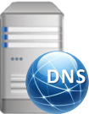

3.1 Given a scenario, implement secure protocols
Domain Name System (DNS)
Host DNS Cache
Stores recently resolved names
Hosts File
The hosts file is the mapping of IP Address to Domain Name
DNS Server (Internal DNS Server)
Maintains only the hostnames for your domain
Host client checks DNS Cache
Host client checks Host File
Host client checks Local DNS Server

Slide 14
3.1 Given a scenario, implement secure protocols
Domain Name System (DNS)
Authoritative Response
Fully-Qualified Domain Name (FQDN) for target host
Hostname = workstation01
Domain = company.com
Fully-Qualified Domain Name (FQDN) = workstation01.company.com.
IP Address = 192.168.1.26
C:\Users\Administrator>nslookup workstation01 Server: dns.company.com. Address: 192.168.1.254 authoritative answer: Name: workstation01.company.com. Addresses: 192.168.1.26
Notes:
https://www.godaddy.com/garage/whats-a-fully-qualified-domain-name-fqdn-and-whats-it-good-for/

Slide 15
3.1 Given a scenario, implement secure protocols
Domain Name System (DNS)
nslookup zone transfer
tcp/53
Specifies which type of records to search for ( A, PTR, SRV, MX or Any)
> set type=ANY (All available records)
Dumps all available records, assuming zone transfers are enabled
Requested ANY records for the domain mysite.org be dumped in domain "example.org".
nslookup mysite.org set type=ANY ls-d example.org
nslookup mysite.org set type= ANY ls-d example.org

Slide 16
3.1 Given a scenario, implement secure protocols
Domain Name System (DNS)
dig zone transfer
tcp/53
AXFR - DNS protocol used during a zone transfer
example.org - Primary name server
mysite.org is the domain that we want to initiate a zone transfer for
mysite.org request or acquires all records from example.org
dig -axfr mysite.org@example.org

Slide 17
3.1 Given a scenario, implement secure protocols
Domain Name System (DNS)
Mail Server Records (MX)
The set type=MX command brings back the DNS details on all mail servers in the domain
The lower preference number is the higher priority (primary mail server)
The server with the higher preference number is lower priority (backup mail server)
Back up mail servers may be more vulnerable to attack
Spammers may deliberately direct mail to one of the backup (high distance) MX servers of a domain first, on the assumption that such a server will have less effective anti-spam filters
Domain | Type | Priority | Host
mysite.org mysite.org | MX MX | 10 20 | mail exchanger = 192.68.102.33 mail exchanger = exchg1.mysite.org
exchg1.mysite.org Internet address = 192.168.102.67

Slide 18
3.1 Given a scenario, implement secure protocols
Domain Name System (DNS)
Domain Name System Security Extensions (DNSSEC) (tcp/53)
Secures DNS Traffic
Transport Layered Security (TLS) best supports the deployment of DNSSEC
Evaluates MX record lookup
Can perform authenticated requests for A and AAA records
Resource Record Signature (RRSIG)
Adds a digital signature to each record Resource
Contains the DNSSEC signature for a record set.
DNS resolvers verify the signature with a public key, stored in a DNSKEY record.
DNSKEY record holds a public key used in the DNS authentication process
Adds public keys to DNS records in the domain
Contains the public key that a DNS resolver uses to verify DNSSEC signatures in RRSIG records.
DNSSEC Prevents DNS poisoning

Slide 19
3.1 Given a scenario, implement secure protocols
Domain Name System (DNS)
Exact mail exchange records
Provides early warning signs from incoming phishing attacks.
Drastically reduce your company’s risk of phishing.
You can take immediate steps to block inbound emails from malicious domains.

Slide 20
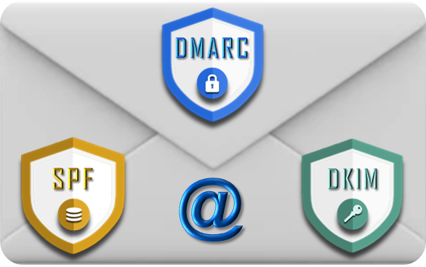
3.1 Given a scenario, implement secure protocols
SPF, DKIM & DMARC
These are mainly authorization, authentication protocols and mechanisms relying mainly on DNS to protect your mail from phishing and spoofing.
Domain Keys Identified Message (DKIM)
Sender Policy Framework (SPF)
Domain-based Message Authentication, Reporting, and Conformance (DMARC)

Slide 21
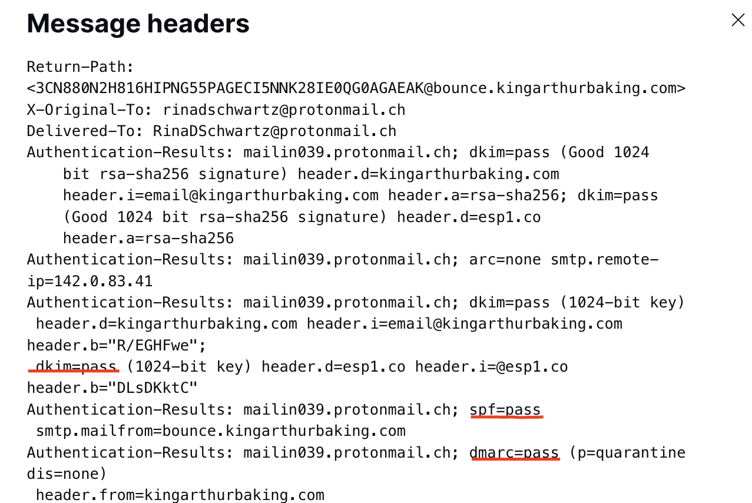
3.1 Given a scenario, implement secure protocols
SPF, DKIM & DMARC

Slide 22

3.1 Given a scenario, implement secure protocols
SPF, DKIM & DMARC
Sender Policy Framework (SPF)
Receiving mail servers verify that incoming messages come from your domain.
SPF specifies the mail servers that are allowed to send email for your domain.
Protects your domain against spoofing.
Prevents your outgoing messages from being marked as spam.
Domain Keys Identified Mail (DKIM)
Signature-based Email Authentication technique.
Standard to help prevent spoofing on outgoing messages sent from your domain
Ensures integrity of sensitive information that is exchanged through email.
Adds an encrypted signature to the header of all outgoing messages.
Email servers that get signed messages use DKIM to decrypt the message header.
Verifies the message was not changed after it was sent.
DKIM

Slide 23
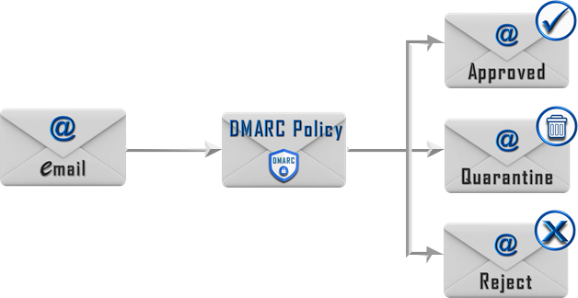
3.1 Given a scenario, implement secure protocols
SPF, DKIM & DMARC
Domain-based Message Authentication, Reporting, and Conformance (DMARC)
Detects when messages don't actually originate from the Internet domain they claim to have been sent from.
Sender messages are protected by SPF and/or DKIM
Tells a receiver what to do if neither of those authentication methods passes
Checks the “From” address domain and compares it with the “Mail from” domain
Protects a domain from being used in outgoing business email compromise attacks
Phishing emails
Spam email
Other cyber threat activities
DMARC

Slide 24


3.1 Given a scenario, implement secure protocols
Secure Shell (SSH)
tcp/22
Encrypted console communication
Remote access
Encrypted remote console login
Encrypts data
Command-line Interface (CLI)
Replaces Telnet
File Transfer
Secure File (SFTP)
Secure File Copy (SCP)
Upload files onto a remote server using a scheduled task
Routing and switching
Encrypted terminal communication
Secure network device configuration
Authentication methods
Public keys are generated for certificate-based authentication (SSH Keys)
Username and password
Microsoft environment, use Kerberos to produce a ticket

Slide 25




3.1 Given a scenario, implement secure protocols
Secure Shell (SSH)
ssh key-based authentication
generate a RSA public and private key pair on the administrator's desktop
ssh-keygen – t rsa
Copy the public key to the SSH server
ssh-copy-id
Test ssh keys
ssh root@server
tcp/22 Control & Data
Remote User
Private SSH Key
Remote Directory
public SSH key

Slide 26
3.1 Given a scenario, implement secure protocols
Secure Shell (SSH)
Secure Copy (SCP)
tcp/22
Is a command-line utility that allows you to securely copy files and directories between two locations.
With scp you can copy a file or directory:
From your local system to a remote system.
From a remote system to your local system.
Between two remote systems from your local system.
Copy a Local File to a Remote System
scp file.txt remote_username@10.10.0.2:/remote/directory
User on the remote server
Path to the directory you want to copy the file to
Name of the file we want to copy
Server IP address

Slide 27



Given a scenario, implement secure protocols
File Transfer Protocols
Secure File Transfer Protocol (SFTP)
System generates a public-private key pair
You link your public key to your account on the SFTP server
Client will produce a signature with private key that the server can confirm with the already-stored public key
public and private keys match up, the connection is established
Keys - Commands - Data
Encrypted Tunnel
SFTP Client
Private SSH Key
SFTP Server
public SSH key

Slide 28
3.1 Given a scenario, implement secure protocols
Secure Shell (SSH)
Secure File Transfer Protocol (SFTP)
Downloading Files:
sftp> get filename.zip
Uploading Files:
sftp> put filename.zip
Create a new directory on the remote server:
sftp> mkdir directory_name
Change the permissions of a file on the remote system:
sftp> chmod 644 file_name
Change the owner of a file on the remote system:
sftp> chown user_id file_name
Establishing an SFTP connection
sftp remote_username@10.10.0.2
Server IP address or hostname
User on the remote server

Slide 29

3.1 Given a scenario, implement secure protocols
Secure Socket Layer (SSL) /Transport Layer Security (TLS)
HTTPS tcp/443
Used to encrypt communications on the Internet
Used to secure network communication
Provides data integrity and communication privacy
Used by web browsers to protect connections between web applications and web servers.
TLS protects data in transit and is an upgraded version of SSL
Manage the SSL/TLS certificates on your local computer using a Graphical User Interface (GUI)

Slide 30
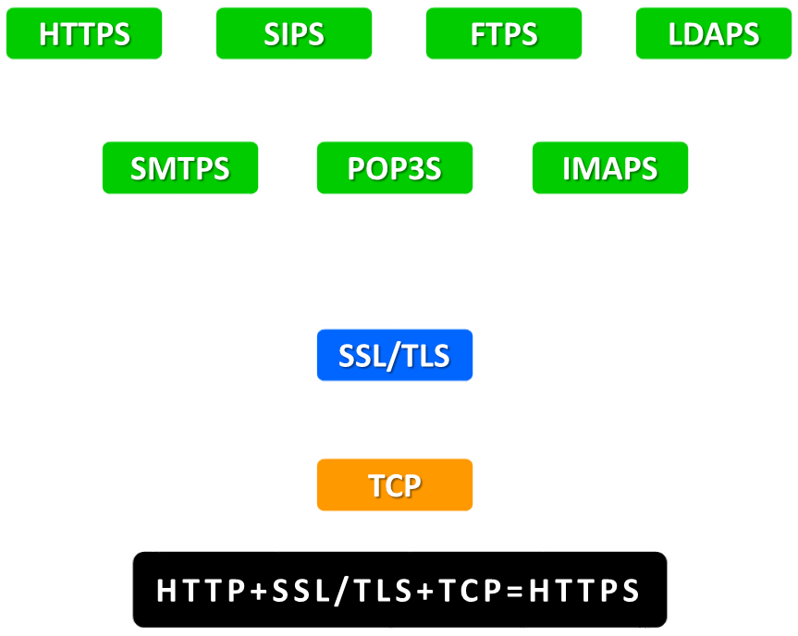
3.1 Given a scenario, implement secure protocols
Secure Socket Layer (SSL) /Transport Layer Security (TLS)
Many other TCP-based protocols use TLS/SSL
Typically, when a service uses a secure connection the letter S is appended to the protocol name, for example, HTTPS, SMTPS, FTPS, SIPS.

Slide 31
3.1 Given a scenario, implement secure protocols
Secure Socket Layer (SSL) /Transport Layer Security (TLS)
Cipher Suites
TLS 1.2
Elliptic Curve Diffie-Hellman Ephemeral mode (ECDHE) for session key Agreement (key exchange)
RSA signatures/Public Key
128-bit AES-GCM (Galois Counter Mode) for bulk encryption (ESP)
256-bit SHA for HMAC functions (AH)
TLS_ECDHE_RSA_WITH_AES128_GCM_SHA256

Slide 32
2.8 Summarize the basics of cryptographic concepts
Secure Socket Layer (SSL) /Transport Layer Security (TLS)
TLS 1.3
Uses simplified and shortened cipher suite
Typical TLS 1.3 cipher suite appears as follows:
Only ephemeral key agreement supported in 1.3
Signature type supplied in the certificate
Cipher suite only lists bulk encryption key strength and mode of operation (AES_256_GCM)
Cryptographic hash algorithm (SHA384) used with each new hash key derivation function (HKDF)
Shared secret established by D-H key agreement used to derive symmetric session key
TLS_AES_256_GCM_SHA384

Slide 33




3.1 Given a scenario, implement secure protocols
Secure Socket Layer (SSL) /Transport Layer Security (TLS)
SSL/TLS Handshake
TLS_ECDHE_RSA_WITH_AES128_GCM_SHA256
ECDHE - Key Exchange
RSA - Web Server Public Key
Session Key encrypted with web server public key (RSA)
AES128_GCM - Session Key
Client request SSL/TLS Session
TLS/SSL certificate & public key sent back
Pre-master key decrypted using private key
This is the server Public key decrypted with the servers Private key
Session key is also decrypted
Encrypted session key sent to server: Client creates session key
Session encrypted with symmetric session key

Slide 34


3.1 Given a scenario, implement secure protocols
Web Browsing Protocols
Hypertext Transport Protocol (HTTP)
tcp/80
Unsecure
Enables clients (typically web browsers to request recourses from an HTTP from an HTTP server.
GET: Something is retrieved FROM a server.
POST: Something is sent TO a server..
Web Logs |  |  |  |  |  | X
Time | SRC IP | SRC Port | Destination IP | DST Port | Request Code | URL
12:01:02 | 192.168.1.6 | 9087 | 85.10.211.94 | 80 | GET | company.com
12:01:03 | 192.168.1.7 | 3456 | 85.10.211.94 | 80 | POST | company.com
12:01:04 | 192.168.1.8 | 12536 | 85.10.211.94 | 80 | POST | company.com

Slide 35

3.1 Given a scenario, implement secure protocols
Web Browsing Protocols
Hypertext Transport Protocol Secure (HTTPS)
tcp/443
Encrypts web traffic with SSL or TLS
Indication of a secure HTTPS session lock icon including HTTPS in the URL field
Transfer files through the Internet in a secure manner
Uses x.509 certificates for authentication
+
=
Example:
A web server should also utilize the latest security techniques and standards Install an X- 509-compliant certificate Enable and configure TLS on the server

Slide 36

3.1 Given a scenario, implement secure protocols
File Transfer Protocols
Trivial File Transfer Protocol (TFTP)
udp/69
Unsecure
File transfer using UDP
Is used to transfer smaller amounts of data
Communication with network devices
Not an essential protocol on most networks (commonly disabled)

Slide 37

3.1 Given a scenario, implement secure protocols
File Transfer Protocols
File Transfer Protocol (FTP)
tcp/20 - tcp/21
Sends and receives files between systems
Unencrypted file transfer
FTP is a client-server protocol that relies on two communications channels between the client and server:
Command channel for controlling the conversation tcp/21
Data channel for transmitting file content tcp/20
FTP sessions work in active or passive modes
Command Channel (control)
Port 21
Data Channel
Port 20
or
High Port
(1024+)
FTP Client
FTP Server

Slide 38
3.1 Given a scenario, implement secure protocols
File Transfer Protocols
File Transfer Protocol (FTP)
Active mode
Client initiates a session via a command channel request
Server creates a data connection back to the client and begins transferring data
Active FTP
FTP control connection to port 21 from high port
FTP Server
Port 20
High Port
(1024+)
FTP Client
FTP data connection initiation from port 20 on server to high port on client

Slide 39
3.1 Given a scenario, implement secure protocols
File Transfer Protocols
File Transfer Protocol (FTP)
Passive mode.
The server uses the command channel to send the client the information it needs to open a data channel.
Passive mode has the client initiating all connections, it works well across firewalls and network address translation gateways.
Passive FTP (PASV)
FTP control connection to port 21 from high port
FTP Server
High Port
(1024+)
High Port
(1024+)
FTP Client
FTP data connection initiation from high port on client to high port on the server

Slide 40
3.1 Given a scenario, implement secure protocols
File Transfer Protocols
FTP Secure (FTPS)
tcp/990 for the FTPS control channel
tcp/989 for the FTPS data channel
Authentication performed via x.509 certificates
Requires a server X.509 certificate and private key
Negotiates a secure session using TCP port 990 for the control channel and 989 for the data channel
This approach enables implicit Transport Layer Security (TLS) as soon as an FTP connection is established.
Port 990 Control Channel
Port 989 Data Channel
FTP Client
FTP Server
Public Key
(Public x.509 Certificate)
Private key
(Private x.509 Certificate)
Encrypted SSL/TLS Tunnel

Slide 41
3.1 Given a scenario, implement secure protocols
File Transfer Protocols
FTP over explicit SSL/TLS (FTPES).
This approach enables explicit TLS support by upgrading an FTP connection over port 21 to an encrypted connection.
Commonly used approach by web and file sharing services to enable secure file transfers.
Client must request security; if they do not, the session will be refused.

Slide 42




3.1 Given a scenario, implement secure protocols
Email Protocols
Email Architecture
SMTP – Outgoing or Send Mail
POP3 / IMAP4 – Incoming or Receive Mail
SMTP
SMTP
IMAP4/POP3
Internet
Mail Sender
SMTP Server
Mail Transfer Agent
(MTA)
SMTP Server
Mail Exchange
(MX)
Mail Sender

Slide 43

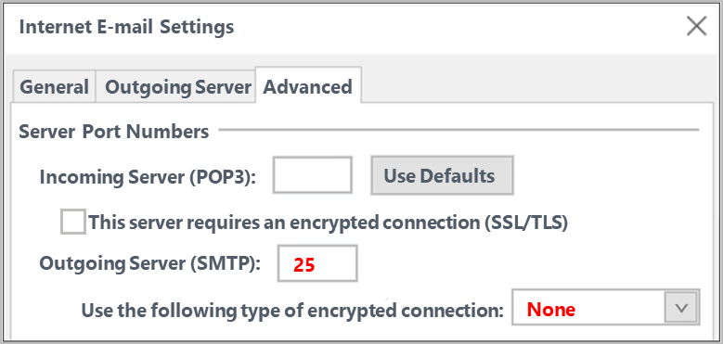
3.1 Given a scenario, implement secure protocols
Email Protocols
Simple Mail Transfer Protocol (SMTP)
Outgoing mail
Transfers email from client -> server
Also transfers from server -> server
tcp/25 - Unsecure

Slide 44
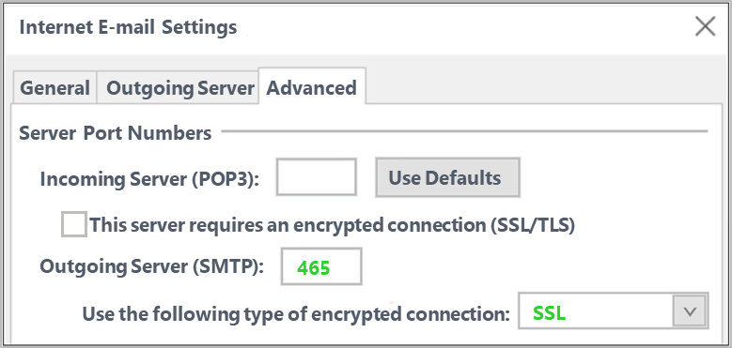



3.1 Given a scenario, implement secure protocols
Email Protocols
Simple Mail Transfer Protocol Secure (SMTPS)
Prevents emails in plain text from being sniffed
tcp/465 – SSL
tcp/587 – TLS
+
=

Slide 45
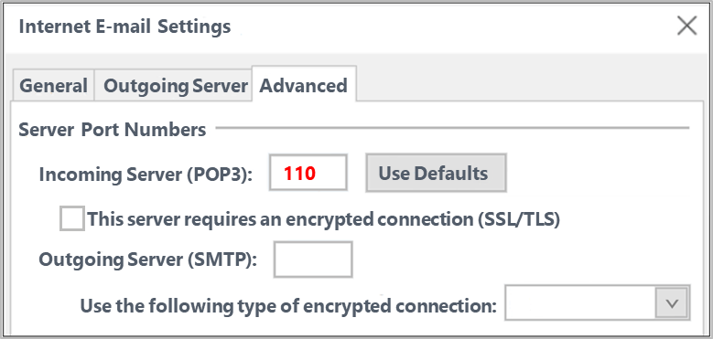
3.1 Given a scenario, implement secure protocols
Email Protocols
Post Office Protocol v3 (POP3)
Incoming mail
Transfers emails from server -> client
Deletes copy of e-mail after transfer and does not save to the server
tcp/110 - Unsecure

Slide 46
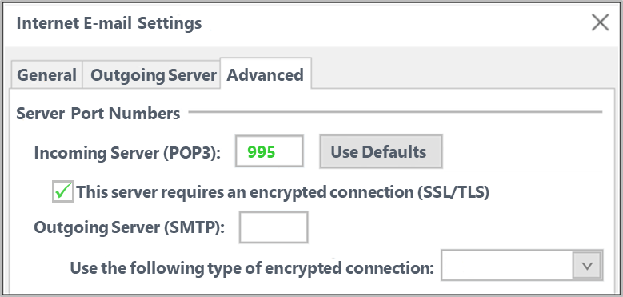


3.1 Given a scenario, implement secure protocols
Email Protocols
Post Office Protocol v3 Secure (POP3)
Provides encrypted logins to the email server
tcp/995 - Secure
tcp/995 - Secure
+
=

Slide 47

3.1 Given a scenario, implement secure protocols
Email Protocols
Internet Message Access Protocol v4 (IMAP4)
Incoming mail
Transfers emails from server -> client
Receives and stores email and remains on the server, example Gmail
tcp/143 - Unsecure

Slide 48
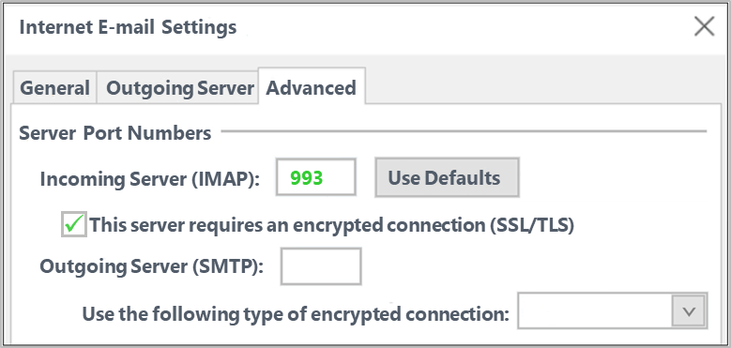


3.1 Given a scenario, implement secure protocols
Email Protocols
Internet Message Access Protocol Secure (IMAPS)
Provides encrypted logins to the email server
tcp/993
Secure – SSL/TLS
+
=

Slide 49
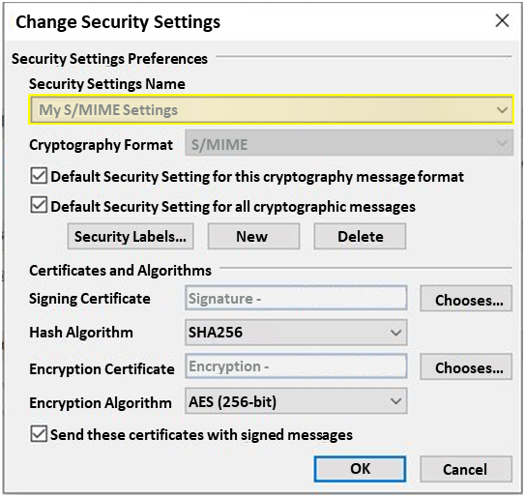
3.1 Given a scenario, implement secure protocols
Email Protocols
Secure/Multipurpose Internet Mail Extensions (S/MIME)
Used for digital signature between two people
Encrypt and sign email using S/MIME
Supports employs certificates generated by the PKI
Implements a stream cipher
Example:
A security consultant is setting up a new electronic messaging platform and wants to ensure the platform supports message integrity validation. The consultant should recommend S/MIME protocol (digital signature)

Slide 50

3.1 Given a scenario, implement secure protocols
Directory Service Protocols
Lightweight Directory Access Protocol(LDAP)
Port tcp/389
LDAP is an open application protocol and works outside of the Windows structure, focusing on Unix and Linux environments.
Stores objects such as users and computers as x.500 objects
Used to communicate with directories over network
The protocol searches and compares the credentials to what the LDAP server has stored for the authenticating user
If the username and password match what’s listed in the directory, LDAP authenticates the user.

Slide 51


3.1 Given a scenario, implement secure protocols
Directory Service Protocols
LDAP Secure (LDAPS)
tcp/636
LDAPS allows for the encryption of LDAP data (which includes user credentials) in transit protecting against credential theft.
LDAP traffic is encrypted
Cannot be monitored or sniffed
SSL or TLS use with LDAPS
Using X.509-compliant certificate that is signed by a trusted CA
+
=

Slide 52
3.1 Given a scenario, implement secure protocols
Directory Service Protocols
Active Directory
Microsoft’s proprietary solution for accessing and managing directories
Windows Active Directory supports both LDAP and Kerberos for authentication
LDAP and Kerberos can be used together one at a time or simultaneously as well.
By default, Windows uses Kerberos for authentication purposes
LDAP used for the same and is used for organizing objects within the Active Directory domain such as:
User accounts
Computers
Organization units (OUs)

Slide 53



3.1 Given a scenario, implement secure protocols
Voice & Video Protocols
Session Initiated Protocol Secure (SIPS)
udp/5061
Initiates and establishes the session
Encrypts credentials used for session authentication on connections to the Private Branch Exchange (PBX)
Allows communication over the Internet, and VoIP communication using
Computers
Tablets
Smartphones
+
=

Slide 54
3.1 Given a scenario, implement secure protocols
Voice & Video Protocols
Secure Real-time Transport Protocol (SRTP)
udp/5061
RTP transfers voice and video traffic
Voice traffic should be placed in its own VLAN to ensure reliability
Protocol enables secure, real-time delivery of audio and video over an IP network
SRTP provides the following for RTP:
Confidentiality – AES Encryption
Integrity – Message authentication

Slide 55
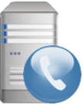
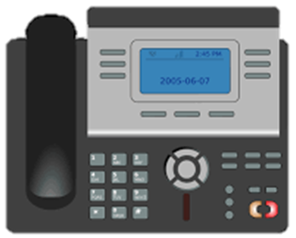

3.1 Given a scenario, implement secure protocols
Voice & Video Protocols
Secure Real-time Transport Protocol (SRTP)
Session Initiated Protocol Secure (SIPS)
“SIPS initiates the call”, encrypts credentials
SIP over TLS
SIP over TLS
SIP over TLS
Private Branch Exchange
(PBX)
Private Branch Exchange
(PBX)
SIPS
Data / Voice transported with UDP, encrypted by SRTP
Certificate
Certificate

Slide 56
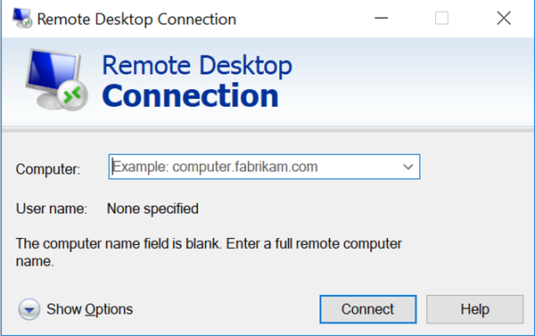
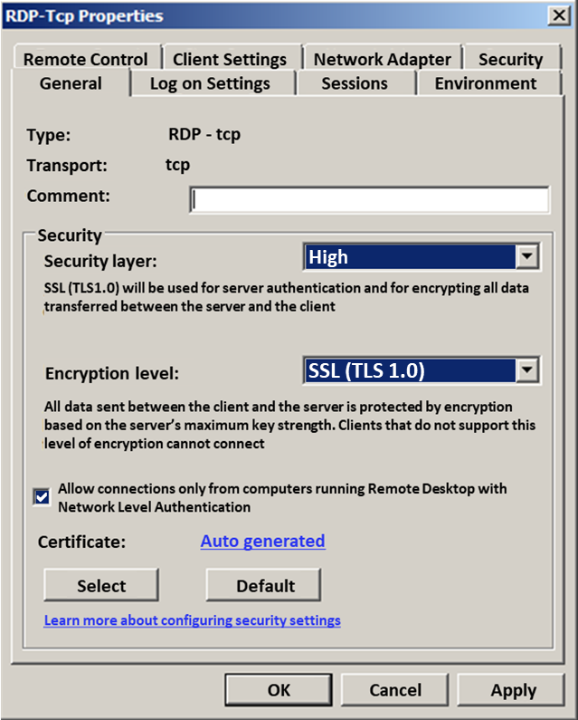
3.1 Given a scenario, implement secure protocols
Remote Desktop Protocol (RDP)
tcp/3389 – udp/3389
Graphical display of remote devices (GUI)
Connect to remote systems
Remote Desktop Connection
Windows Remote Assistance
Remote Desktop can be secured using SSL/TLS
Remote Desktop sessions operate over an encrypted channel, preventing anyone from viewing your session by listening on the network.
A vulnerability in the method used to encrypt sessions in earlier versions of RDP
Vulnerability can allow unauthorized access to your session using a man-in-the-middle attack

Slide 57




3.1 Given a scenario, implement secure protocols
Remote Desktop Protocol (RDP)
Remote Desktop Gateway (RDG or RD Gateway)
provides a secure encrypted connection to the session remote desktop session host via RDP.
It enhances control by removing all remote user access to your system and replaces it with a point-to-point remote desktop connection.
Access the server/session host using RDP on a port other than the typical registered port for the RDP protocol
SSL Tunnel tcp/443
SSL Tunnel tcp/443
Tcp/3389
RDP Client
Firewall
Remote Desktop
Gateway
Remote Desktop
Session Host

Slide 58
Given a scenario, implement secure protocols
Remote Access Protocols
Administrators connect to servers remotely using protocols such as:
Secure Shell (SSH)
Remote Desktop Protocol (RDP)
Virtual Private Networks (VPN)
Telnet Port 23 Run remote command—unsecure (cleartext)
Netcat (nc) is useful for remotely administering servers
Netcat is to establish connections (sockets)
Linux administrators use Netcat when connecting to remote systems
Secure the Netcat transmissions with SSH

Slide 59

3.1 Given a scenario, implement secure protocols
Simple Network Management Protocol
Simple Network Management Protocol
udp/161 for SNMP Managers communicating with SNMP Agents
Networking protocol used for the management and monitoring of network-connected devices in Internet Protocol networks
Accessible using their IP address
SNMP protocol is embedded in multiple local devices such as:
Routers
Switches
Servers
Firewalls
Wireless access points
udp/162 Simple Network Management Protocol Trap (SNMPTRAP)
when agents send unsolicited Traps to the SNMP Manager

Slide 60



3.1 Given a scenario, implement secure protocols
Simple Network Management Protocol
Simple Network Management Protocol 3 (SNMPv3)
Version 3 added encrypted communication instead of SNMPv1 and v2
Encrypts credentials and traffic between network devices
Includes authentication and encryption of SNMP messages as well as protecting packets during transit.
The first version of SNMP and SNMPv2 had vulnerabilities, such as passing passwords or traffic across the network is in clear-text
+
=

Slide 61

3.1 Given a scenario, implement secure protocols
Time Synchronization Protocols
Network Time Protocol (NTP)
udp/123
Most commonly used protocol for time synchronization
Simple NTP (SNTP)
udp/123
Not as accurate as the result from NTP
Typically for smaller systems with less dedicated processing power

Slide 62
3.1 Given a scenario, implement secure protocols
Time Synchronization Protocols
Public NTP Servers vs. Local NTP Servers
There are two types of NTP servers that you can use to provide UTC time to your network:
External (public servers)
A external time server is owned and operated by a third party
Made available for use over the Internet
Requires an open port on the firewall making your network vulnerable
Internal (local servers)
NTP servers are those you own yourself and install in your premises
Physical network connection between your servers and clients
Internal time servers are the safer, more reliable option

Slide 63

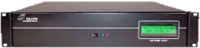

3.1 Given a scenario, implement secure protocols
Time Synchronization Protocols
External (Public) NTP Servers vs. Internal (Local) NTP Servers
External NTP Servers
Requires an open port on the firewall making your network vulnerable
Internal NTP Servers
NTP Server is behind the firewall leaving your network fully protected

Slide 64
3.1 Given a scenario, implement secure protocols
Time Synchronization Protocols
Stratum 0: The atomic time clock or reference time server
Stratum 1: An internal time server that synchronizes its time with a Stratum 0
Stratum 2: An internal time server on a remote subnet that synchronizes its time with the Stratum 1 time server
A Stratum 0 time server is the ultimate authority in a Stratum time server environment
It is the atomic clock or GPS that time should be synchronized with
If there is no internal Stratum 1 NTP server, then we will use an internal Stratum 0 NTP server
Example:
Due to regulatory requirements, server in a global organization must use time synchronization. The following represents the MOST secure method of time synchronization The server should connect to internal Stratum 0 NTP servers for synchronization

Slide 65

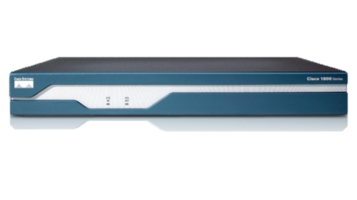

3.1 Given a scenario, implement secure protocols
Time Synchronization Protocols
Stratum 0
Atomic clock
GPS clock
Very accurate
GPS Satellite
Stratum 1
Synchronized to stratum 0 servers
Primary time servers
NTP Time Server
GPS
Antenna
Stratum 2
Sync’d to stratum 1 servers
Server/Workstations
Switch/Router
Ethernet
Clock

Slide 66
Answer the questions
During a security audit of a company’s network, unsecure protocols were found to be in use. A network administrator wants to ensure browser-based access to company switches is using the most secure protocol. Which of the following protocols should be implemented?
SSH2
TLS1.2
SSL1.3
SNMPv3
Confidential emails from an organization were posted to a website without the organization’s knowledge. Upon investigation, it was determined that the emails were obtained from an internal actor who sniffed the emails in plain text. Which of the following protocols, if properly implemented, would have MOST likely prevented the emails from being sniffed? (Select two.)
SMTPS
S/MIME
POP3
IMAP4
SMTP
Notes:
Answers:
1. d (SNMPv3 supports the strongest cipher suite available TLSv1.3 and TLSv1.2 and SSH is CLI not browser-based)
2. a and b

Slide 67

QUESTIONS

Slide 68
2. Ports, Protocols & Services
3.1 Given a scenario, implement secure protocols
2.1 Explain the importance of security concepts in an enterprise environment

Slide 69
69

